Slide 1

Price Analysis on Geyser

Slide 2
About us
Shraddha kalaskar
B.Sc(comp.)
Heena Mohammed
BCA

Slide 3
Contents:
Problem statement.
Introduction
Tools(Libraries) used.
Website URL for Web Scrapping process.
Data Frame
Data Cleaning
EDA
Summary
Challenges

Slide 4
Problem statement:
Which features affects on the price of geysers effectively.
Why geysers cost different , amounts by exploring factors like Model type , color and storage capacity.
How these features affect geyser Prices.
What really matters when it comes to geyser Pricing.

Slide 5
Introduction
The purpose of the analysis : Understanding how various Features impact Geyser Prices.
Based on :
Liters
Brand
Model Type
Color

Slide 6







Technical Stack
Tools (Libraries) Used :
Requests
Beautiful Soup
Pandas
NumPy
Matplotlib
Seaborn

Slide 7
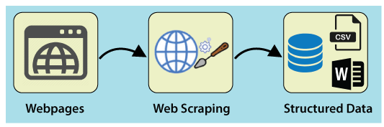
Collection of the data www.flipkart.com

Slide 8
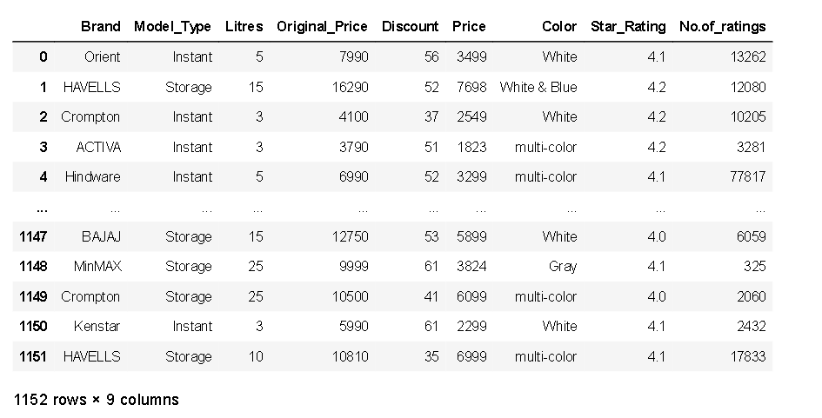
Data Frame :
Insights : shape – In our data set we have 1152 rows × 9 columns

Slide 9

Data cleaning steps:
Drop unnamed columns.
Missing values.
Outliers.
Duplicate values.
Type casting.
Finding outliers.

Slide 10
Summary statistics of Data Frame :
 | Litres | Original_Price | Discount | Price | Star_Rating | No.of_rattings
count | 1152.000000 | 1152.000000 | 1152.000000 | 1152.000000 | 1152.000000 | 1152.000000
mean | 11.139757 | 8061.379340 | 47.657986 | 4178.043403 | 4.091667 | 14500.114583
std | 8.650794 | 3739.820403 | 10.112368 | 2012.526738 | 0.111541 | 20138.429543
min | 1.000000 | 1999.000000 | 27.000000 | 849.000000 | 3.700000 | 123.000000
25% | 3.000000 | 4849.000000 | 41.000000 | 2720.000000 | 4.100000 | 2605.000000
50% | 10.000000 | 7629.000000 | 50.000000 | 3599.000000 | 4.100000 | 10205.000000
75% | 15.000000 | 10500.000000 | 53.000000 | 6099.000000 | 4.200000 | 16964.000000
max | 25.000000 | 16290.000000 | 71.000000 | 7698.000000 | 4.200000 | 77817.000000
Insights
The average price of geysers are 4178.043403.
Minimum starting price of geysers are Rs.849.

Slide 11
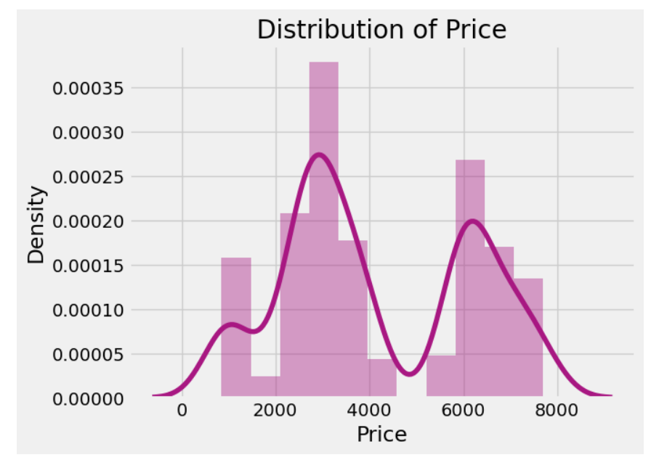
Distribution of target column
The distribution of the Price is not normally distributed and it is obvious that commodities with low prices are sold and purchased more than the branded ones.

Slide 12
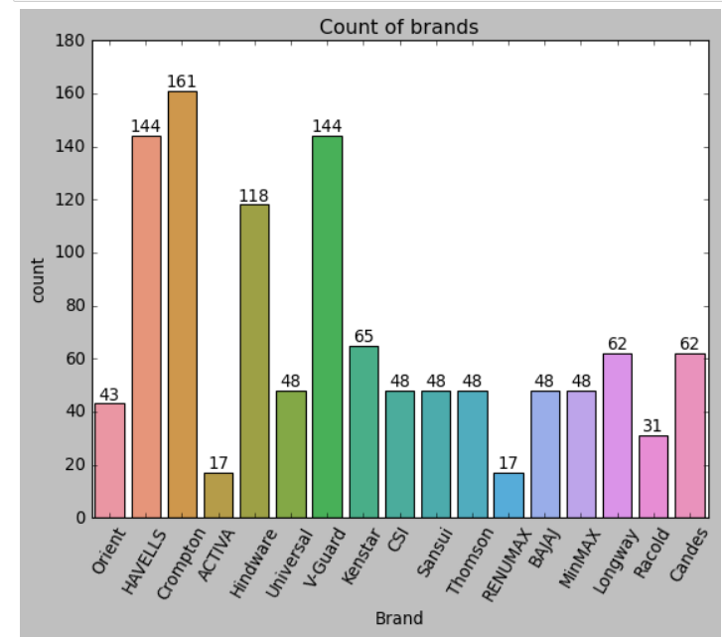
Most Available Geysers in Dataset

Slide 13
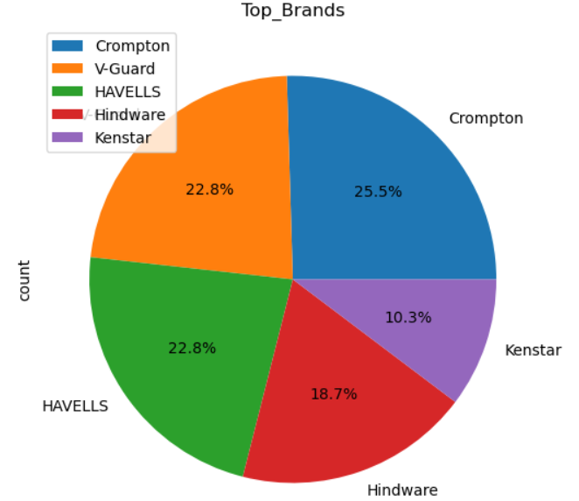
TOP 5 brands
Top – 1 is Crompton followed by V-Guard.

Slide 14
Brand | Min Price | Max Price | Avg

Slide 15
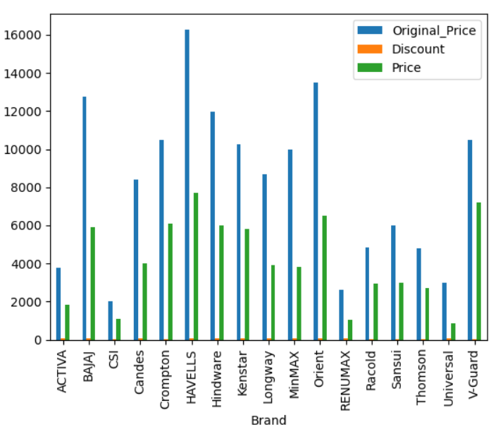
Price Analysis
We can observe the change between original price and price based on discount.

Slide 16
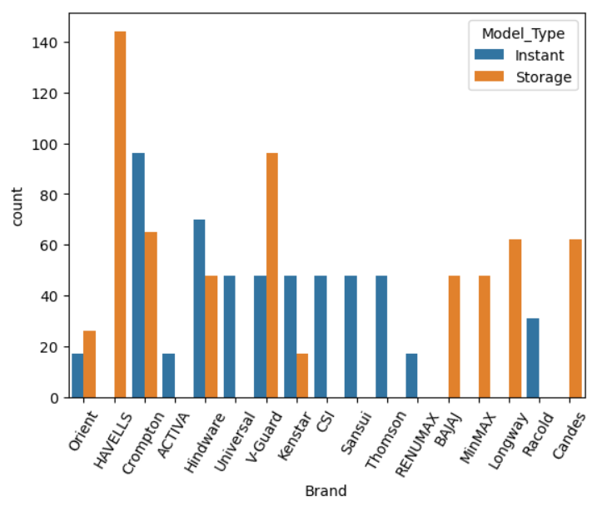
Model type Analysis
We can see that, storage model type are sold more in Havells and instant model type are sold more in Crompton .

Slide 17
Model Type | Available Litres | Min Price | Max Price
Instant | 1,3,5 | 849 | 3499
Storage | 10,15,25 | 3049 | 7698

Slide 18
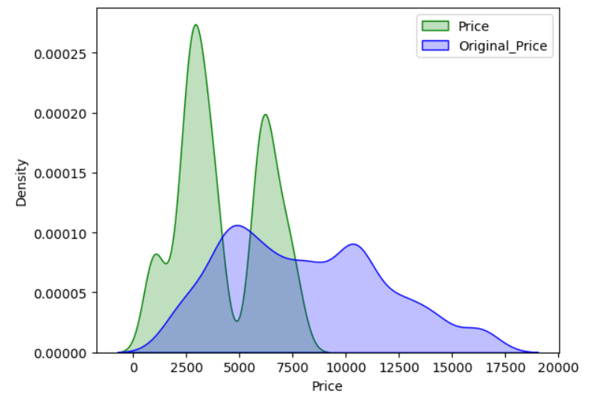
Comparison between Original_Price and Price

Slide 19
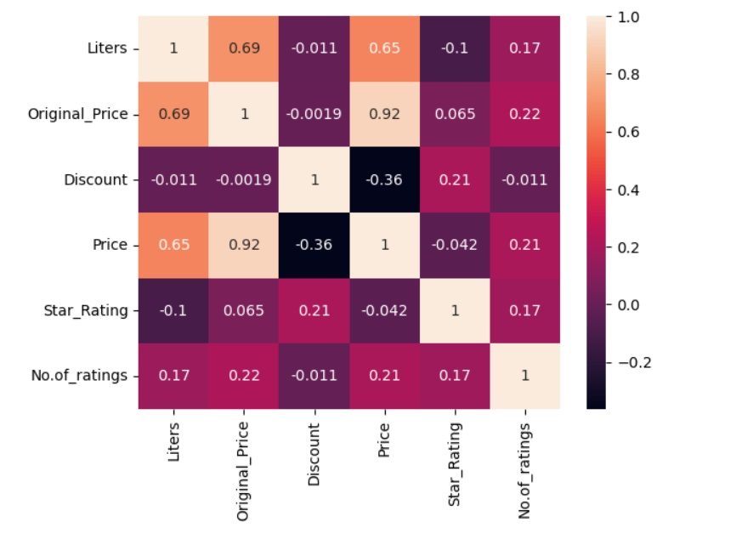
HEAT MAP

Slide 20
Summary :
RAM size significantly affects prices.
Processor type places a notable role.
Storage capacity also contributes to price variations.
APPLE is most expensive laptop brand compare to other brands the price is between 160k
the second most expensive laptop brand is MICROSOST the price is 120k
Lenovo ,ASUS,HP and Dell laptop brands are in same price is around 58k
least expensive laptop brand is primebook the price is 10k

Slide 21
Challenges faced
We have to scraped the data of every tabs in the website, there is a huge work to take the data from the website.
The major challenge is finding website which have whole data we want where we face a lot of null values in column .
Missing values are the main thing u struggle of where it is a dataset of fact where we cannot take mean mode or median for these

Slide 22

THANK YOU

